Slide 1
Improve and Empower Rakuten Ichiba ! !
To Provide Enjoyable Shopping Experience
Notes:
Hi everyone ! we are the Daily Goods Team.
We will now present to you our project entitled Improve and Empower Rakuten Ichiba.
My name is Taishin.

Slide 2
Adenda
1. Team Introduction
2. Overview
3. Rakuten Ichiba Problems
4. Solutions
5. Advantages & Summary
6. Q&A
Notes:
This is our agenda.
We have here team introduction, theme, Rakuten ichiba problems, solutions, advantages & Summary, and Q&A.

Slide 3





Team Introduction
Nicky
Sora
Taishin
Archer
Yu
Notes:
archer(アーチャー)、Nicky(ニッキー)、Sora(そら)、
Let me introduce to you my teammates first.
We all like anime. That's why our images are all anime.
This is Nicky.
Next is archer, this is Sora, then this is Yu.

Slide 4

Overview
Our theme is to improve the site for shopping Daily Goods !
１. Discover Problems in current Rakuten Ichiba.
２. Propose several Solutions and Develop an easy-to-use site.
By using which focuses on daily good,
our team developed three solutions.
Notes:
in this page, i’ll talk about presentation overview.
The theme of our project is to improve the Rakuten Ichiba system for daily goods.
And, we aim to acquire more customers and improve the user experience.
To achieve the goal, we first looked for problems in the current Rakuten Ichiba.
Next, we discussed several solutions to the problems and developed a web site that is easier to use for daily goods.
In the end, our group developed three solutions for three problems.
From now, we are going to talk about these three problems and solutions.
To give details about this, i’ll give the floor to my teammate, Nicky!

Slide 5
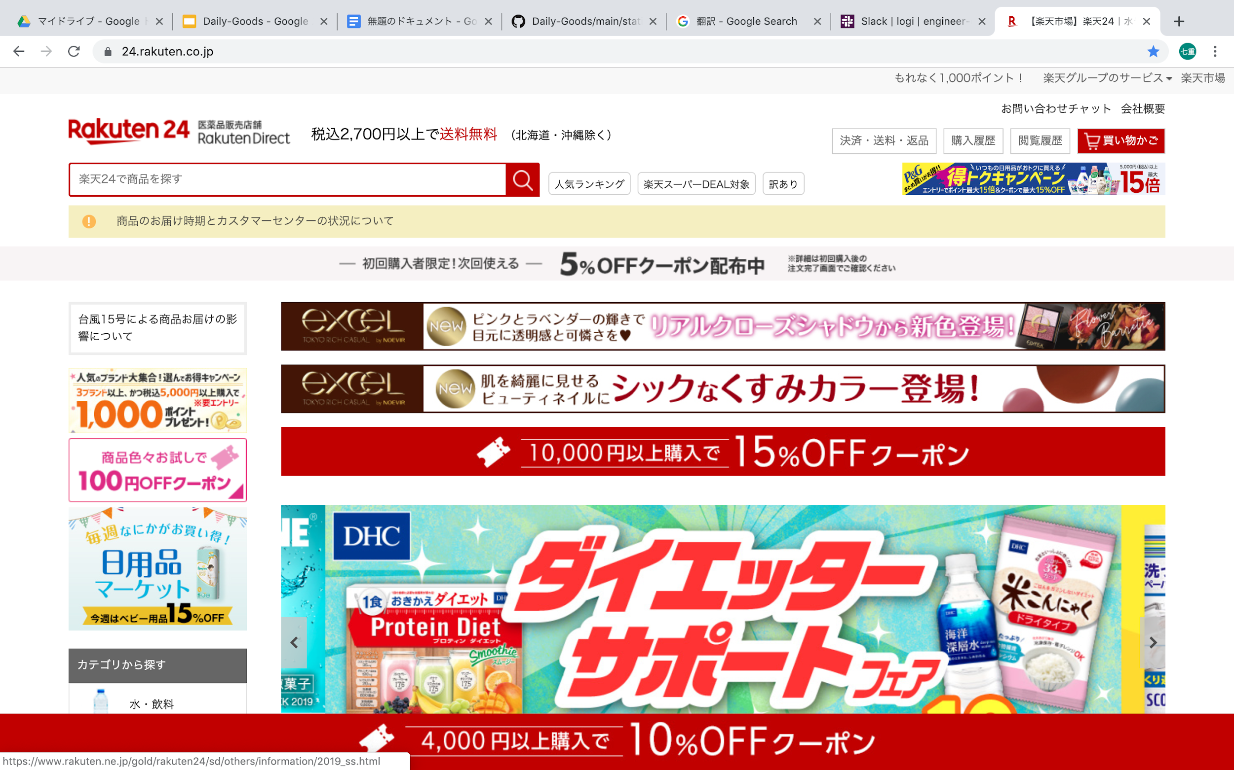
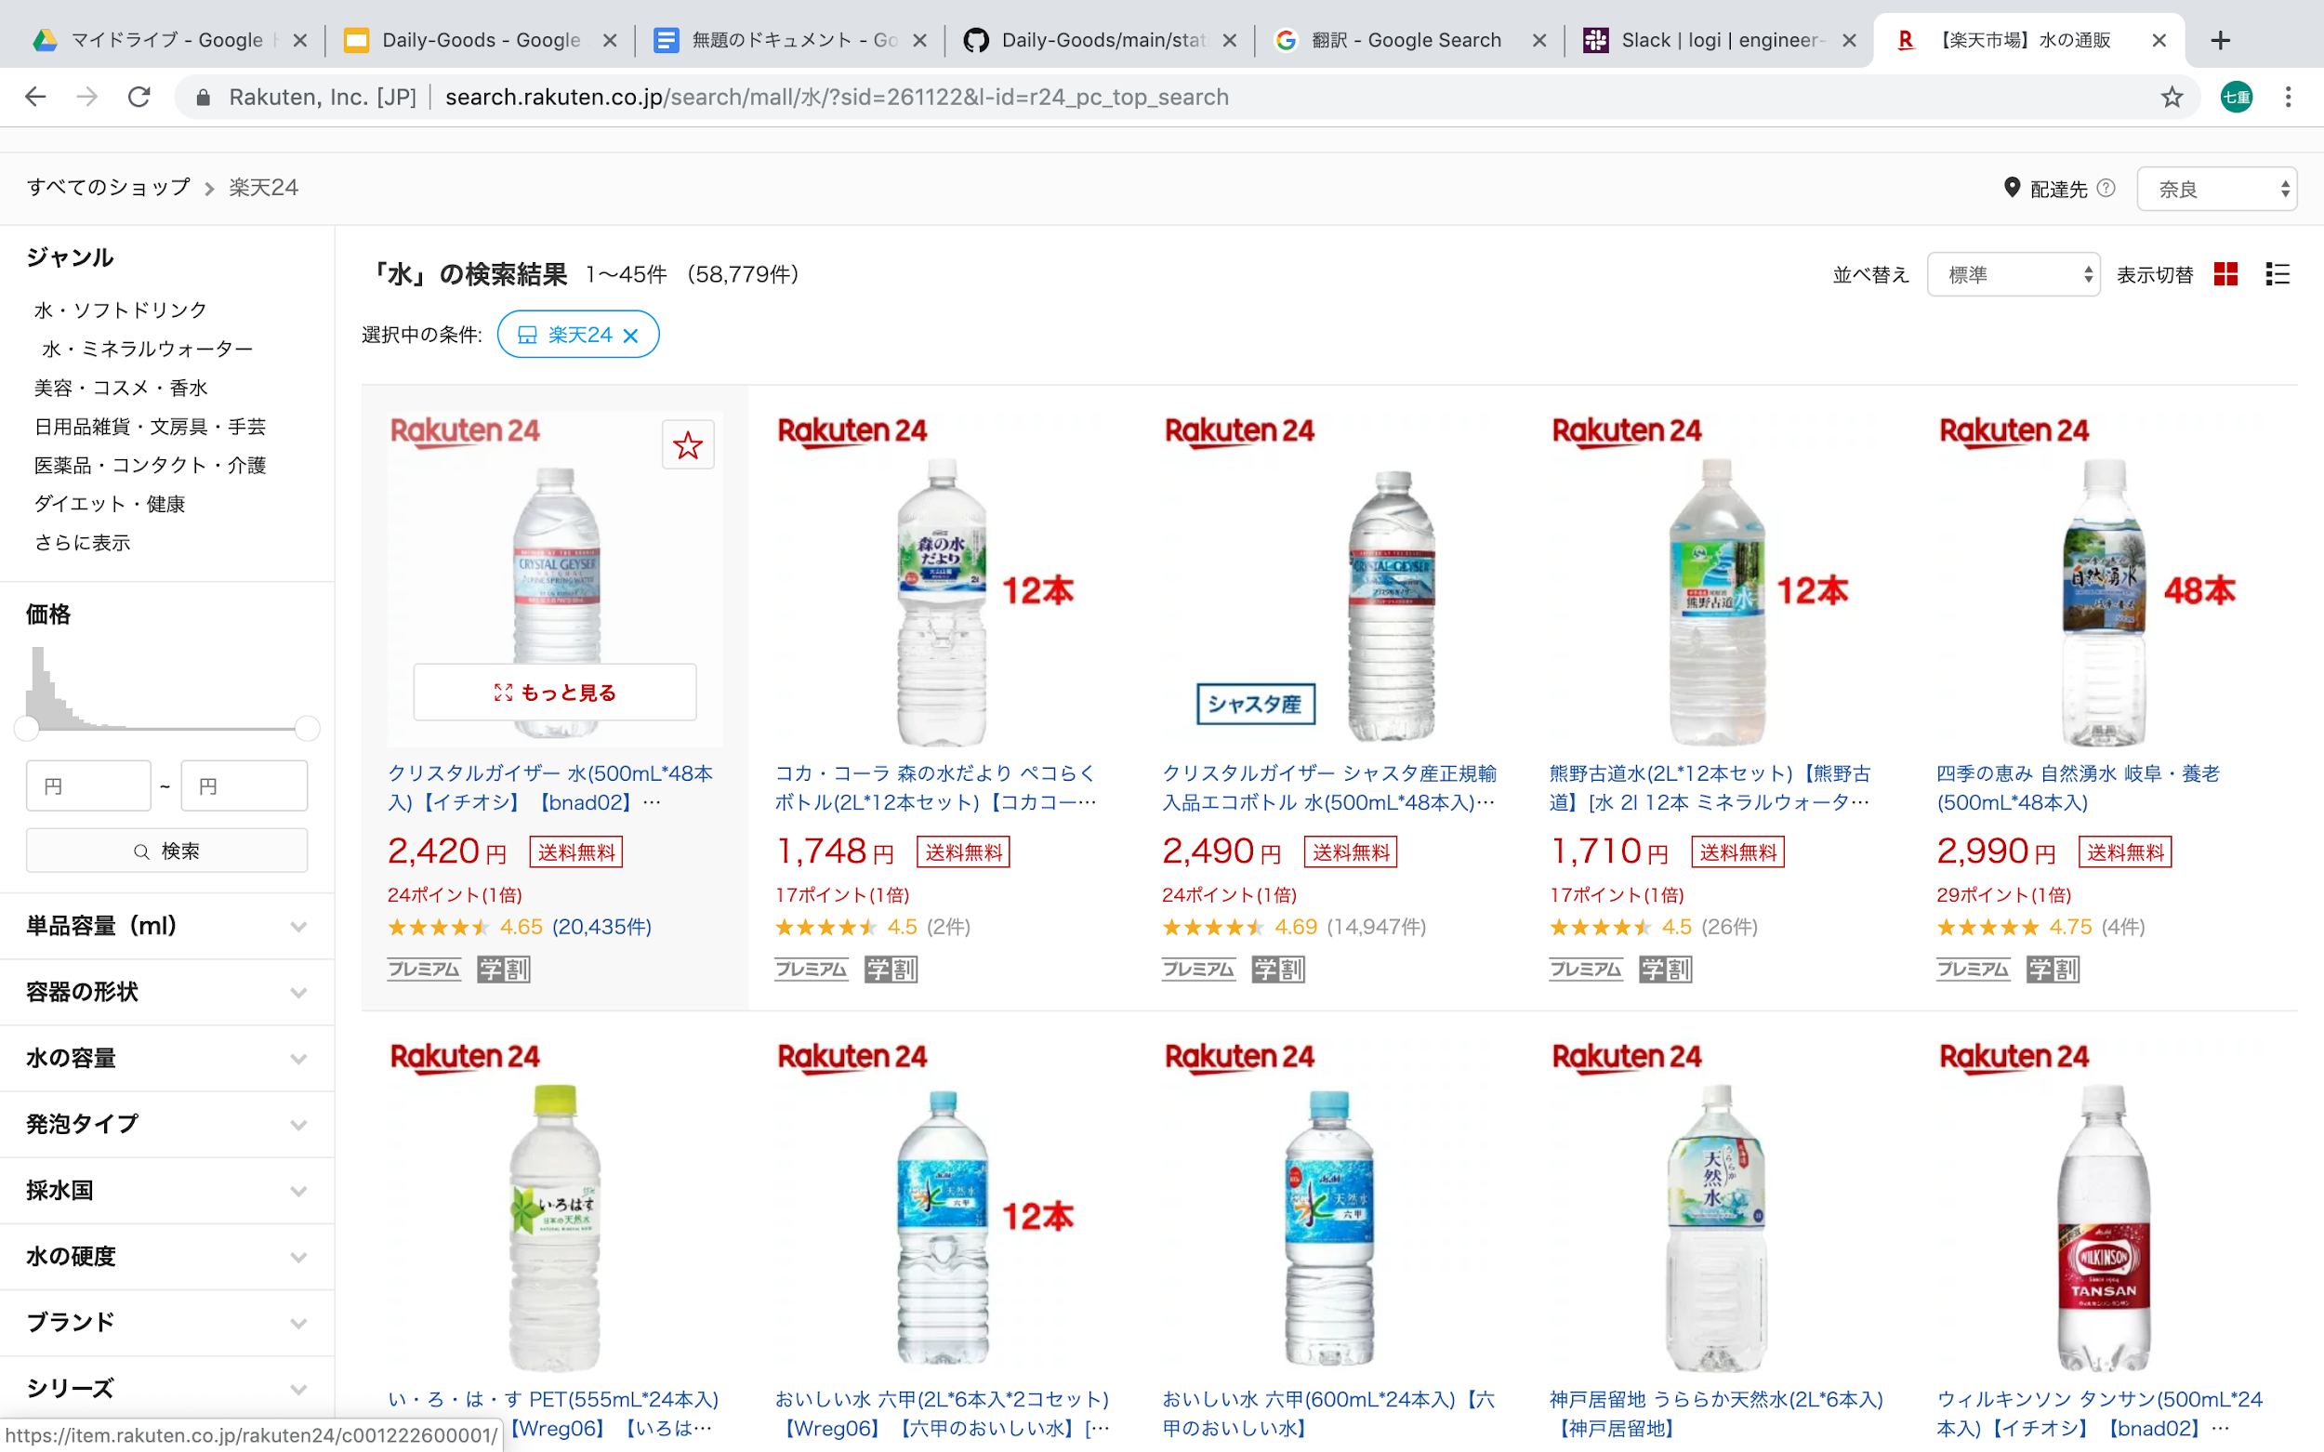
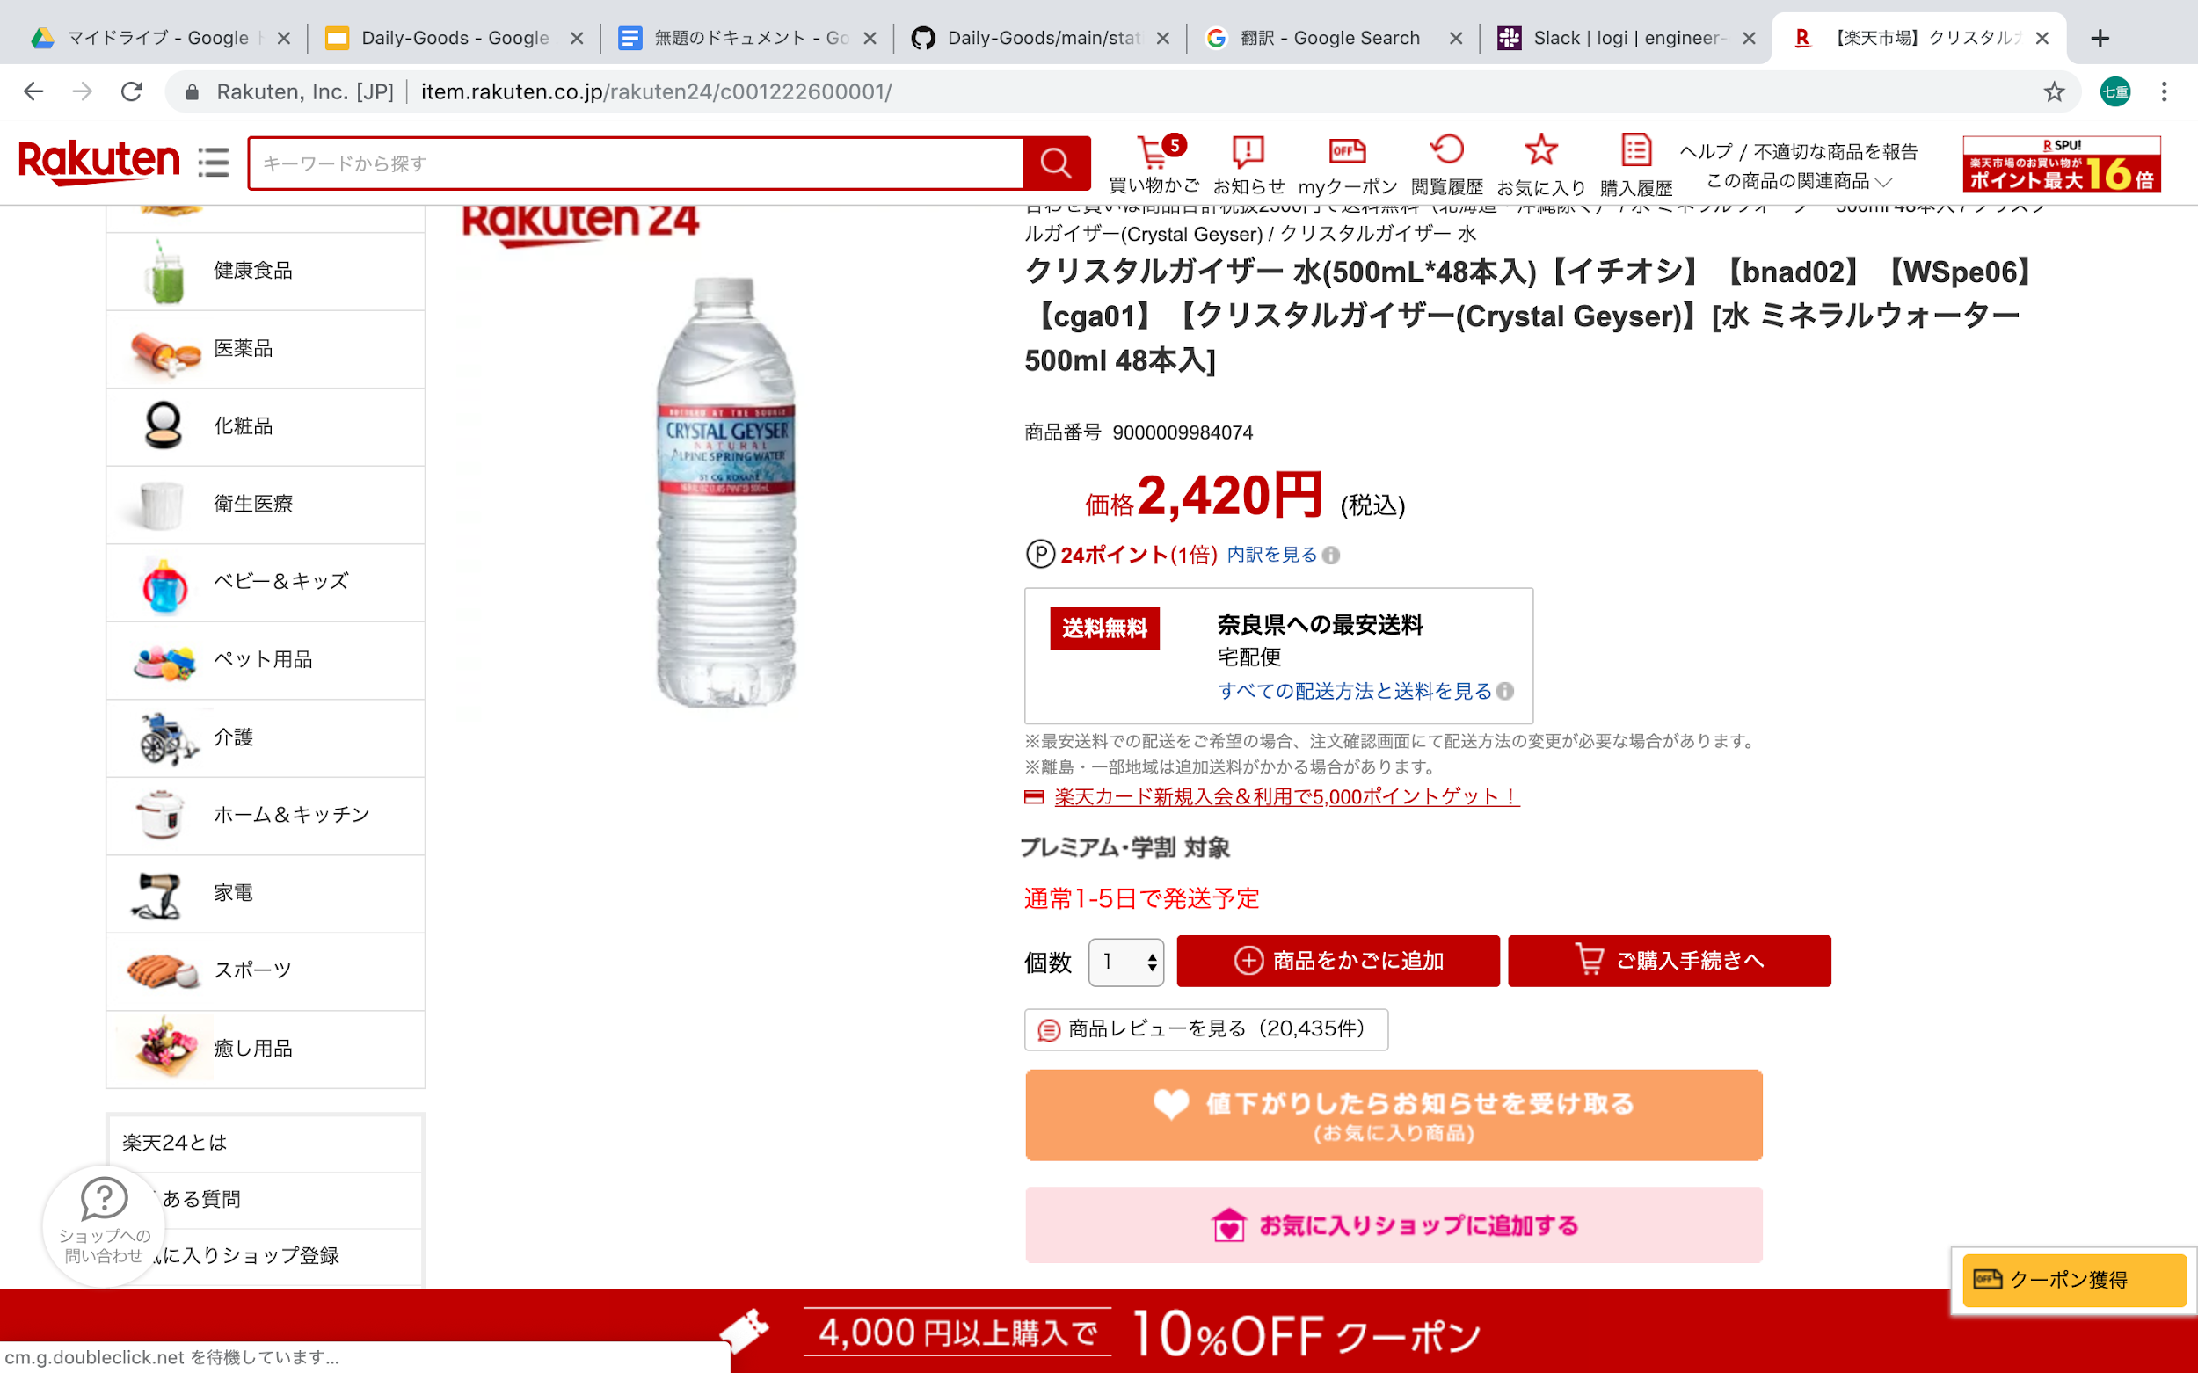
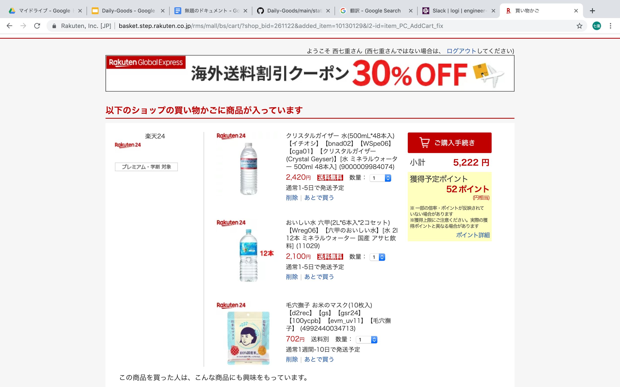
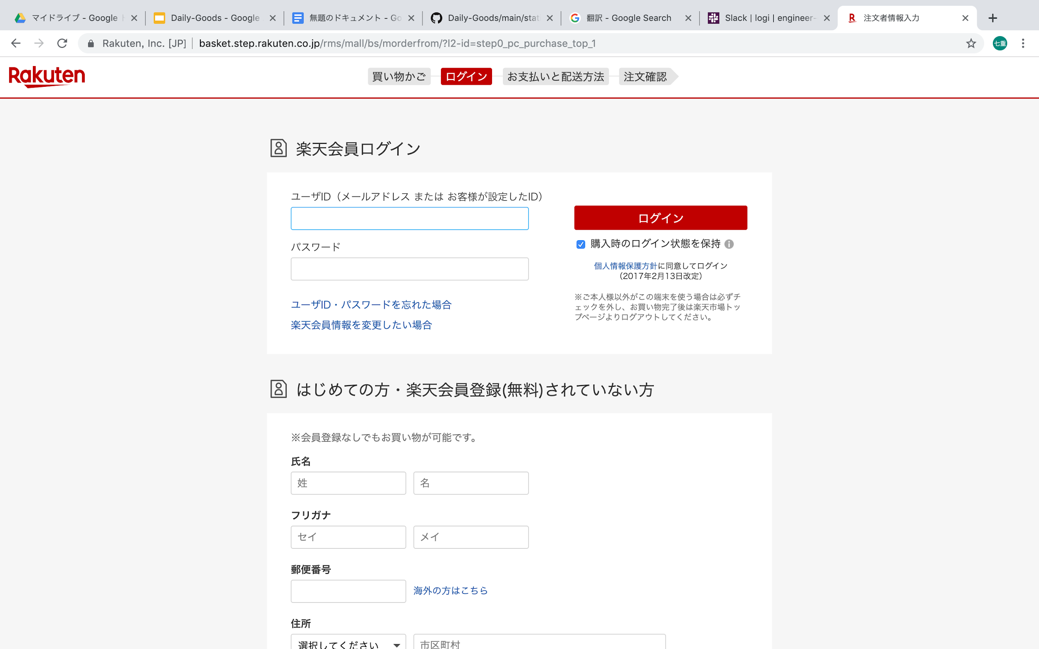
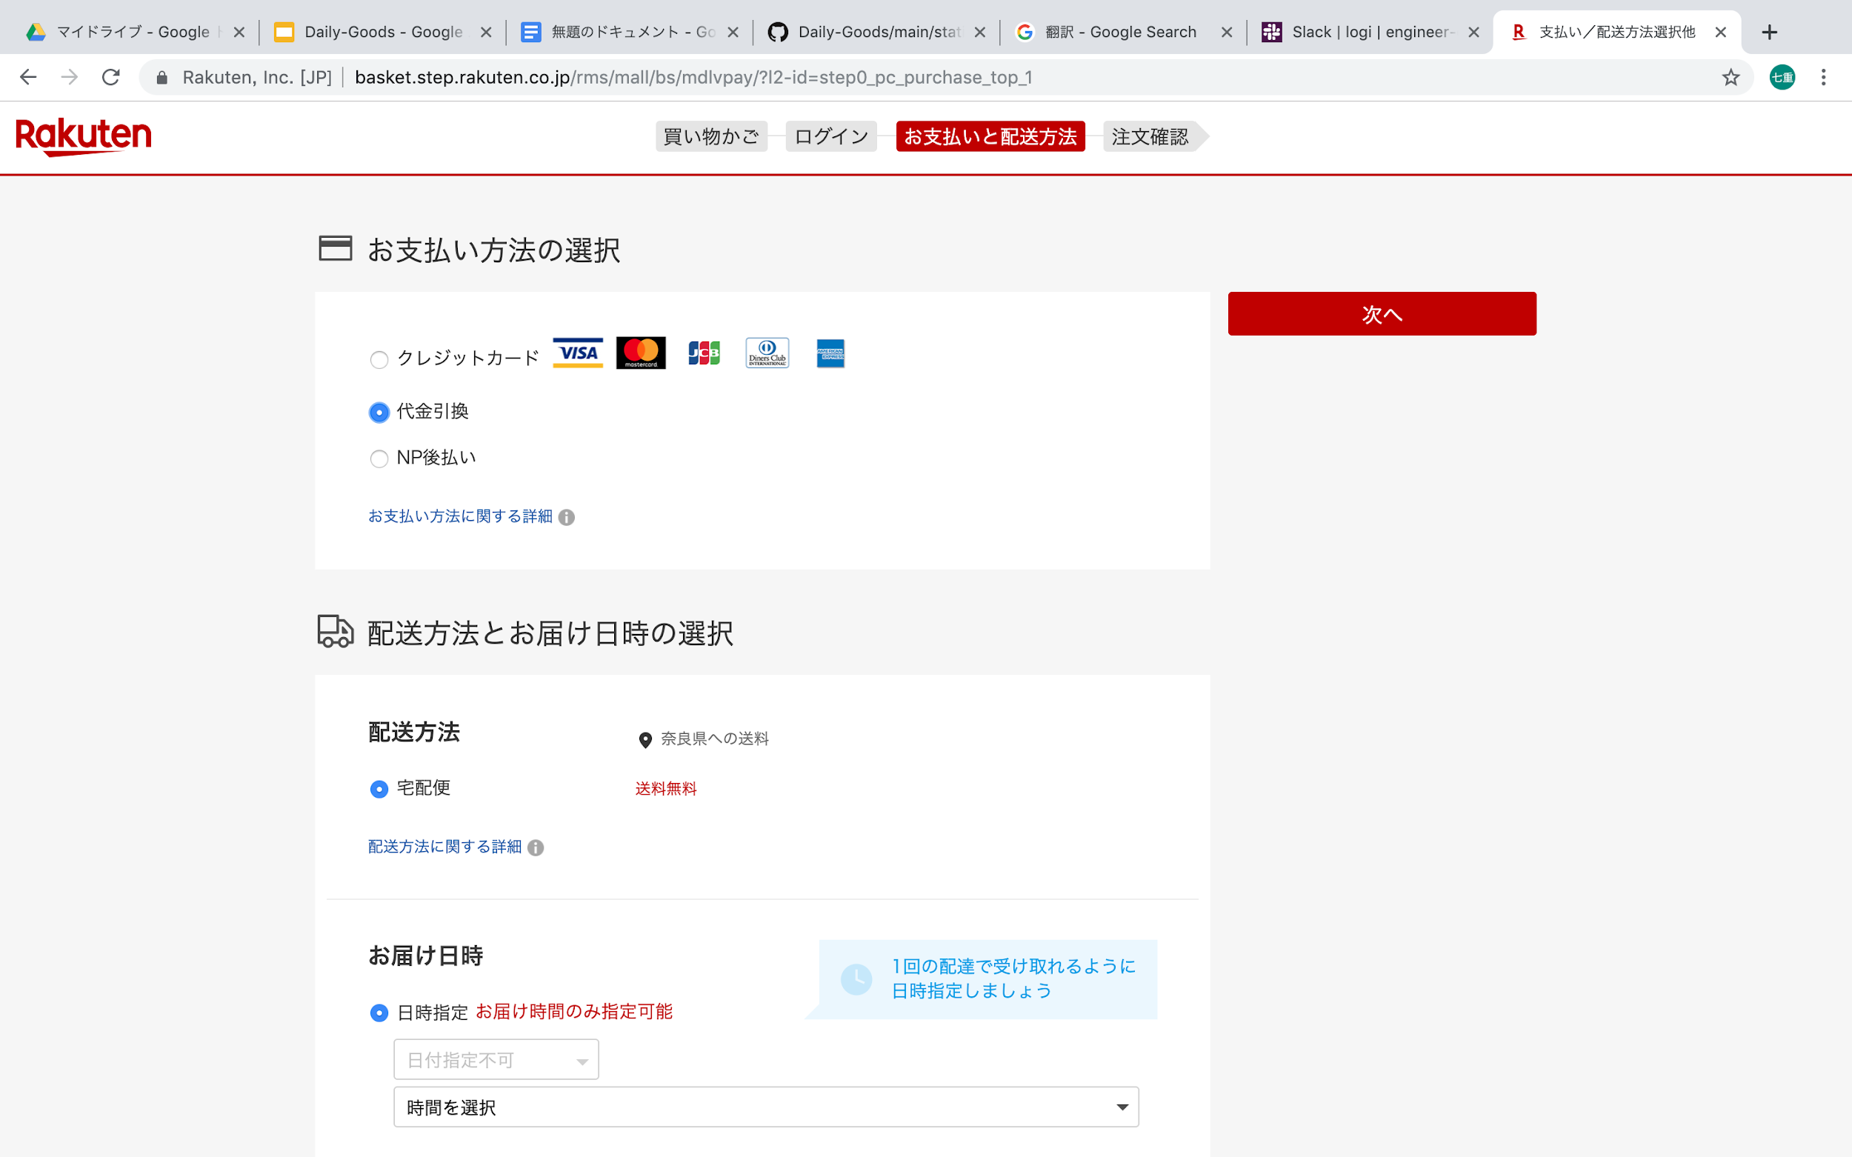
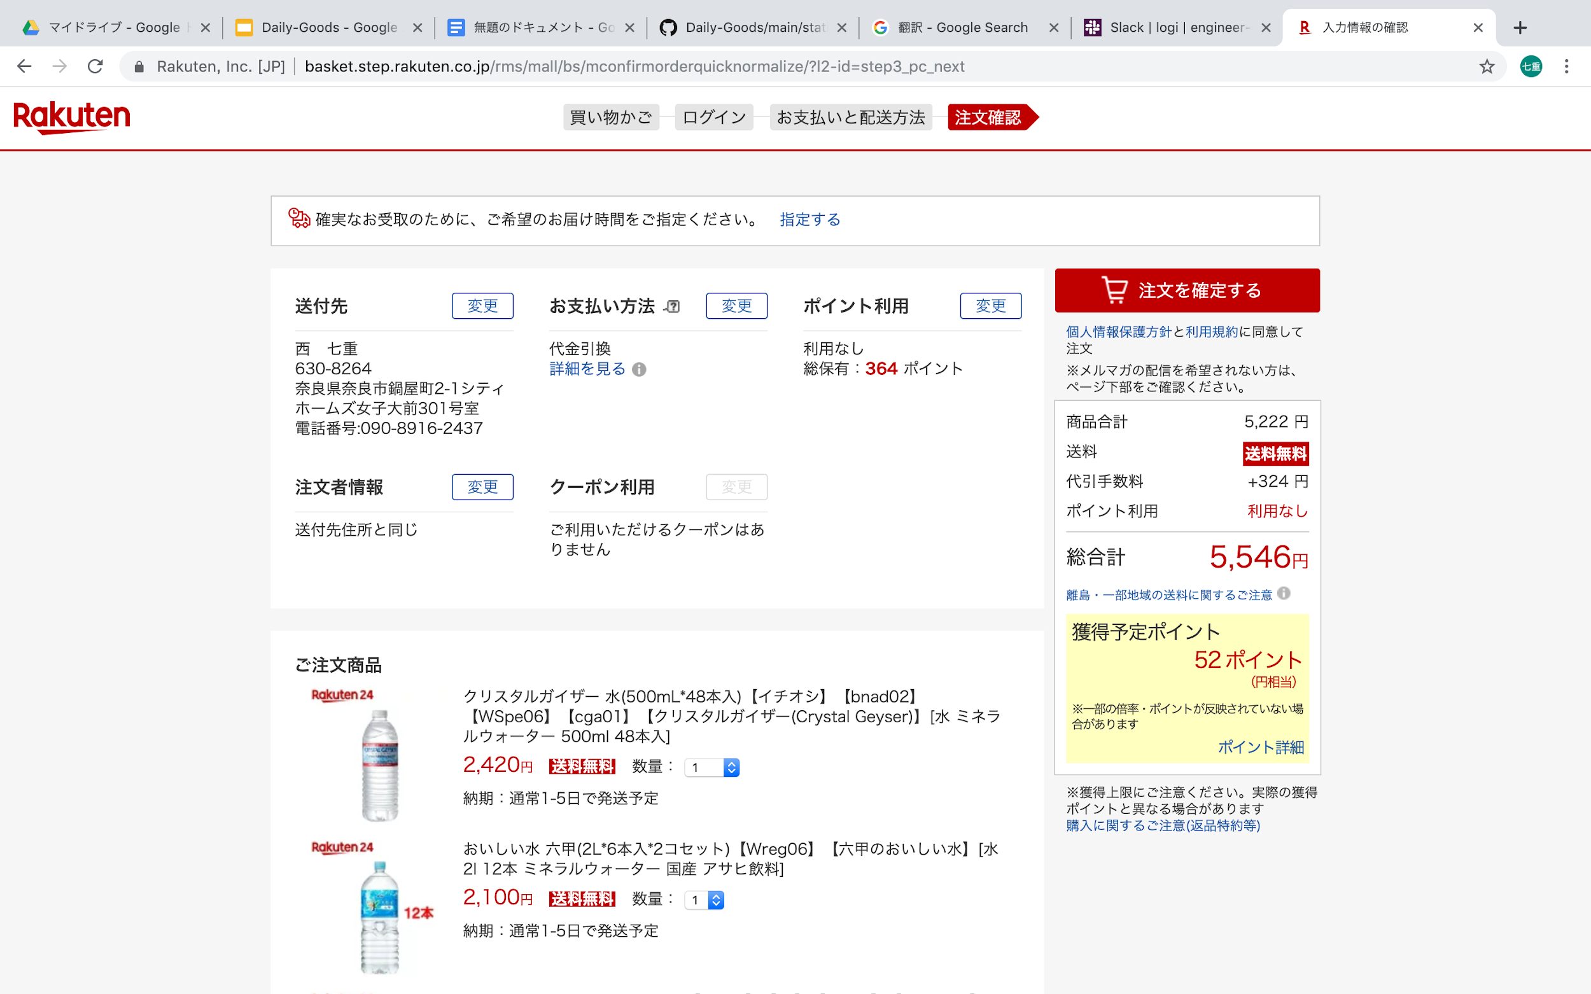
Problem 1: problems in links
It takes a lot of time because we have to skip many links until final page.
click
click
click
click
click
click
Notes:
Hi,I’m Nicky
Next,I’d like to talk about three problems which we found
Firstly , the problem about too much links
Frequently,we have to skip the link many times before the payment is over and,
It makes us confused or frustrated
For users who have already decided what to buy,it’s troublesome for them to jump to the product detail page thus,It takes a lot of time to skip many links.
This is so inconvenient.
(場合によってページを行ったり来たりしないといけない
Depending on the situation you have to go back and forth between pages so we need more link)

Slide 6
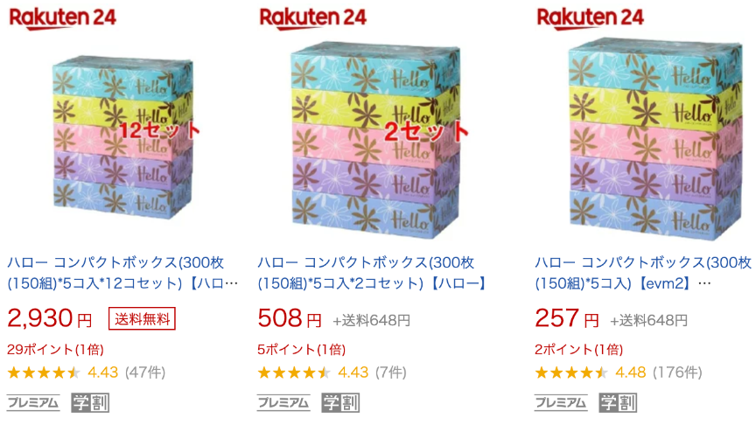
Problem 2: problems in search result page
Unit price is not displayed
There are multiple different product pages for the same product
Notes:
Secondly,I’d like to talk about the problems in search result page
Please look at the picture, As you can see, only the price of the set is displayed
current pages don’t display unit price.
If we want to know the most cheapest unit price, It’s so inconvenient
next,There are multiple different product pages for the same product
Not necessarily next door, It’ll take more time to find your favorite goods 12 pieces

Slide 7
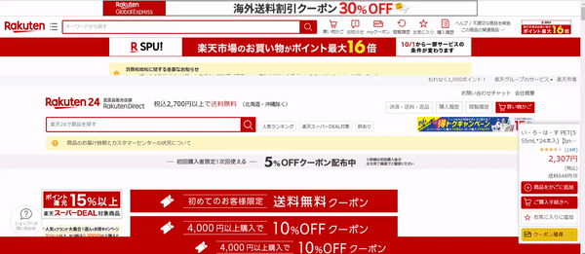
Problem 3: problems in product detail pages
The page is vertically long.
“purchase” button is placed at the bottom of the site.
Notes:
Thirdly, I’d like to talk about problems in product detail pages
This page is vertically long so we have to scroll a lot to see the detail
It’s very hard to see
and “purchase” button is placed at the bottom of site As a result,
It has become a webpage that is difficult to shop
These are problems which we found. we will introduce the web page that we develop to solve these problems To give details about this ,let me introduce you to my groupmate Archer

Slide 8
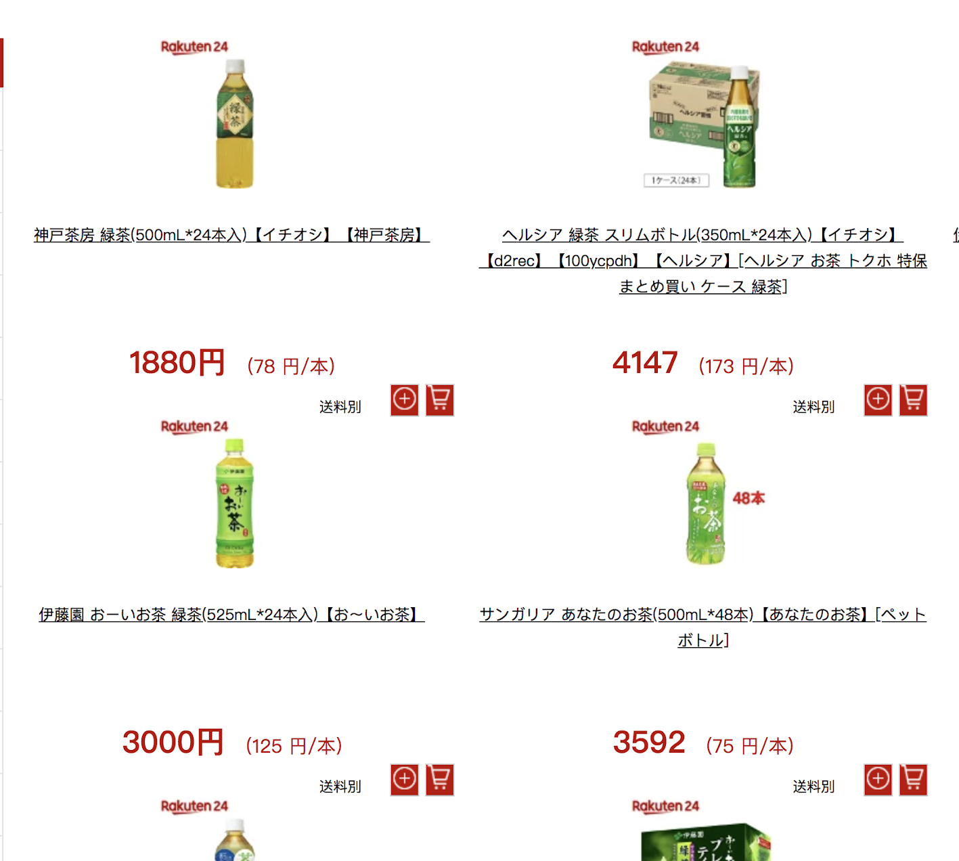
Solution 1: add purchase button and change layout
Problem
Buying goods of favorite brand takes a lot of time
Finding desired goods of the same product to different site is harder
Proposal
With one-click, get what you want
Integrate into one website and show the unit price
Notes:
making a link , with just one-click it will direct you to the Rakuten shopping page
if u are looking for your favorite brand of a product, once you click the link, it will proceed to the shopping page
and there is no need for you to click the products’ link because you already know its details.
moreover, in one website you can see not only the details of the product, but of course its price
the main point of this is that if you re looking for a product with no brand in particular
you can use this link and you can see more various products with different brands
and their specific details
From there, you can compare and decide which brand of the product that you would like to purchase
And then I have here my teammate sora to give the next details.

Slide 9
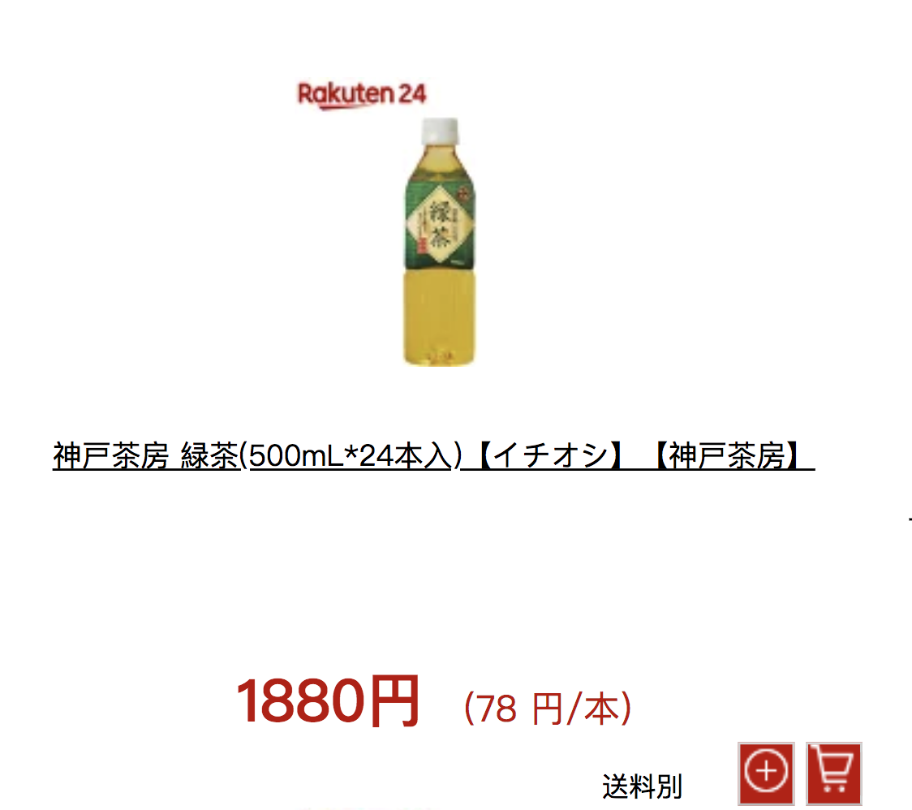
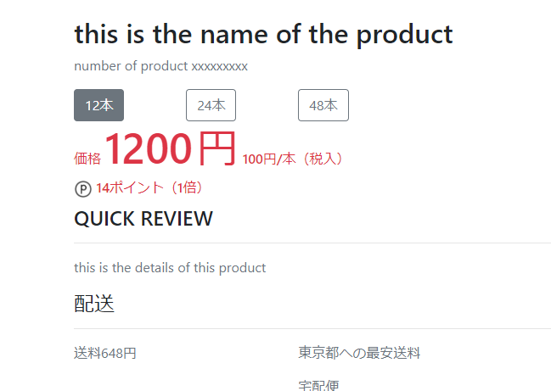
Solution 2 : add numbers and unit price
Problem
NO unit price
Multiple product pages for the same product
Proposal
Show unit price of each product
Add buttons to choose the number of products.

Slide 10
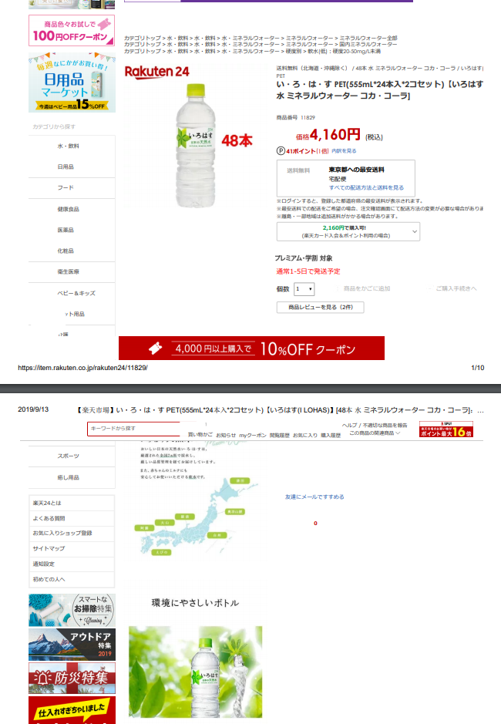
Solution 3: optimize layout
Problem
The page is vertically too long to get useful information.
Proposal
Display images compactly.
Notes:
３つ目の問題点は商品紹介ページが縦長で見辛くなっていることでした．改善方法として個別の商品ページで画像を一つの場所にまとめて表示することで、ページを見やすくしました また商品ページの面積を圧縮することができたため，買い物かごも見つけやすくなりました

Slide 11

Show our advantages by data
Login
Visa
Top page
Login
Proposal
Visa
Button
confirmation page
 | Current | Ours
Links | 6 pages | 4 pages
Time | 60 sec | 38 sec
(Original research)
Notes:
I’ll show our advantages by data.
We set prior condition from top page to purchase confirmation page
and set customer condition customer who have already decided what to buy and need login to their account.
Comparing the current and our methods,
Before a link contains 6 pages and now we make it into 4.
The time to complete the purchase has been improved from 60 seconds to 38 seconds.
By the way,this is an original research,conducted by Nishi.

Slide 12
Show the our advantage by data
This improvement can ...
simplify web page
Speed increased 158 %
Notes:
With this improvement, the speed to purchase has been increased by 158%.
This acceleration is expected to lead to customer repeats.

Slide 13
Summary
We proposed three improvements.
Display of a product’s unit price
Installation of product quantity selection buttons
Summary of product images
158% speedup was enabled by solving problems.
Customer repeatability can be expected by speeding up purchases.
Notes:
Summary

Slide 14

Other issues
When do you really need advertisements?
Buying daily-goods?
Buying expensive items such as furniture?
Notes:
In solving this problem, We found another issue to consider.
We targeted daily-goods.
We were sometimes fed up with lots of ads.
We thought that when do you really need advertising?
Buying daily-goods? or buying expensive items such as furniture?

Slide 15
Issues (Hypothesis)
We expect that the display of ads will need to change depending on the product type.
This is just a hypothesis.
So we have to research more.
Notes:
We expect that the display of ads will need to change depending on the product type.
We have to research more,when should I emphasize ads and what kind ads display that doesn’t make uncomfortable for buyers?
This is just a hypothesis.
So we have to research more.
That's all.
Thanks for listening.

Slide 16

Thanks for listening!
by ECLD members
Sep 13th 2019

